Slide 1
Web Technology 1
Introduction to HTML
HTML
Meta Tag
Text Formatting Lists
Tables Frames

Slide 2
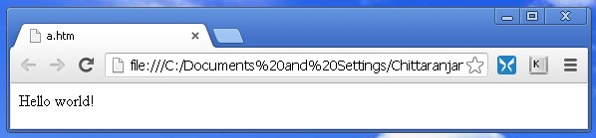
HTML
HTML
HTML (HyperText Markup Language) is the language for
HTML
creating web pages and other information that can be displayed in a web browser
Meta Tag
Text Formatting Lists
Tables Frames
HTML documents are written using HTML tags embedded
in angular brackets. W3C (World Wide Web Consortium)
has defined the HTML tags
AWeb Pageis a web document with .htm or .html extension
AWeb browseris a specific software program required to
display Web pages
<HTML>
Hello world!
</HTML>

Slide 3
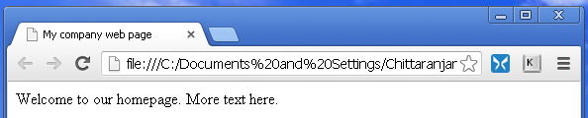
HTML...
Adding a Title
Header contains important information about the page
HTML
Meta Tag
Text Formatting Lists
Tables Frames
Title is the small text that will appear in title bar of viewer’s
browser
Body is the part in which the web page content are entered
Eachembedded tag has both opening and closing tags
Standalone tags don’t have closing tags
<HTML>
<HEAD>
<TITLE>My company web page</TITLE>
</HEAD>
<BODY>
Welcome to our homepage. More text here.
</BODY>
</HTML>

Slide 4
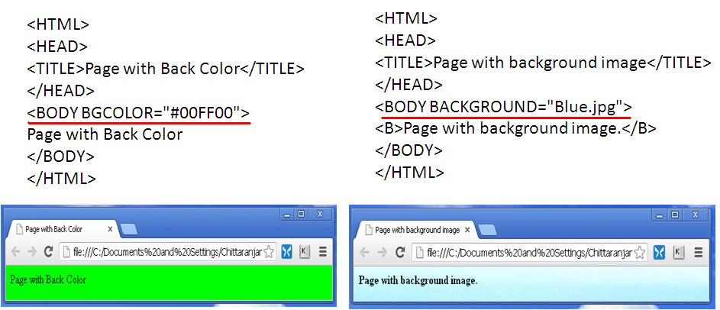
HTML...
HTML Comments
HTML comment starts with <!- - and ends with - ->
HTML
Meta Tag
Text Formatting Lists
Tables Frames
HTML Background
BGCOLOR is used to set the background color. It can be
set using specific color or 6-digit hexadecimal color code
BACKGROUND is used to set the background image

Slide 5
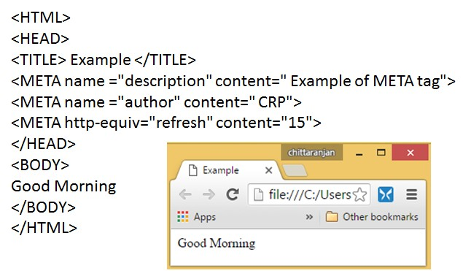
Meta Tag
Meta Tag
It provides metadata about the document. Metadata will
not be displayed on the page
Meta Tag
Text Formatting Lists
Tables
Frames
These are used to specify page description, keywords,
author of the document, last modified etc
It always go inside the <HEAD> tag

Slide 6
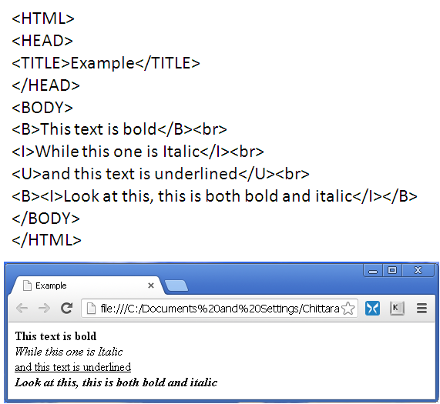
Text Formatting
Text Formatting
Bold, Italic, Underline
HTML
Meta Tag
When you use nested tags you must be sure that they do
Text Formatting
not overlap each other. They must be nested exactly
superscript: <sup> and subscript: <sub>
Lists
Tables Frames

Slide 7
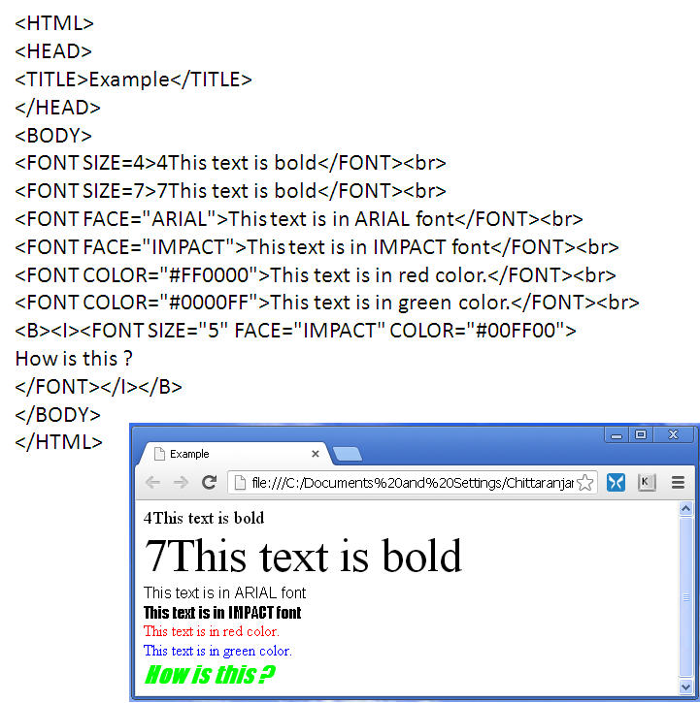
Text Formatting...
Text Formatting
HTML
Meta Tag
Text Formatting Lists
Tables Frames

Slide 8
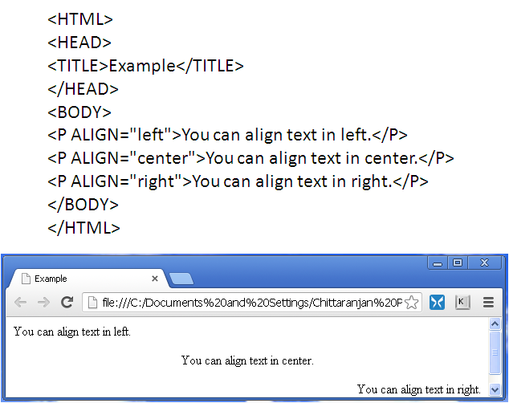
Text Formatting...
Heading
There are 6 levels of headings h1 through h6. h1 has the largest and h6 has the smallest font size
Text Formatting
Paragraph
Lists
Tables Frames
Paragraph: <P>
&nbsp; is used to insert a space

Slide 9
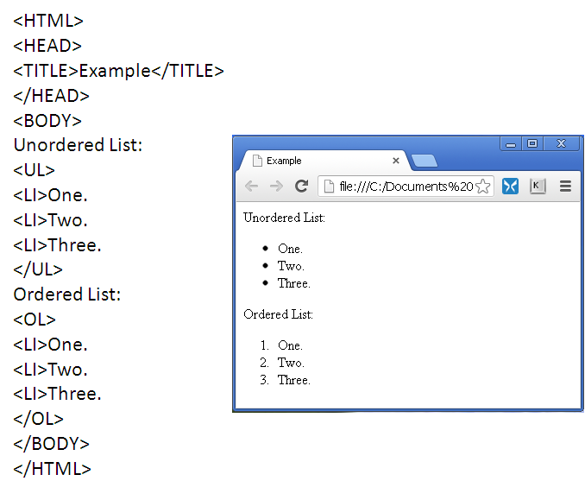
Lists
Lists
List is a collection of one or more items Unordered List: type: disc, circle, square Ordered List: type: 1, A, a, i, I
start: 4, C
HTML
Meta Tag
Text Formatting
Lists
Tables
Frames

Slide 10
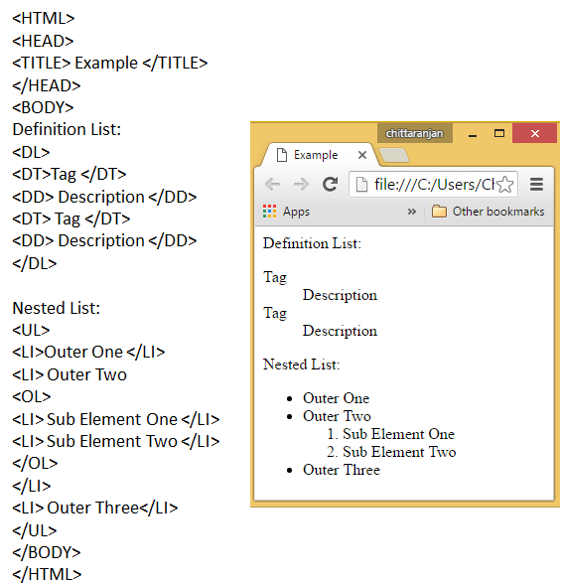
Lists...
Lists
Definition List: list items consist of two parts: a term and its description
Nested List: Nested lists may be used to display sub-elements of an item. Any of the three types of lists may be nested in another
Lists
Tables
Frames

Slide 11
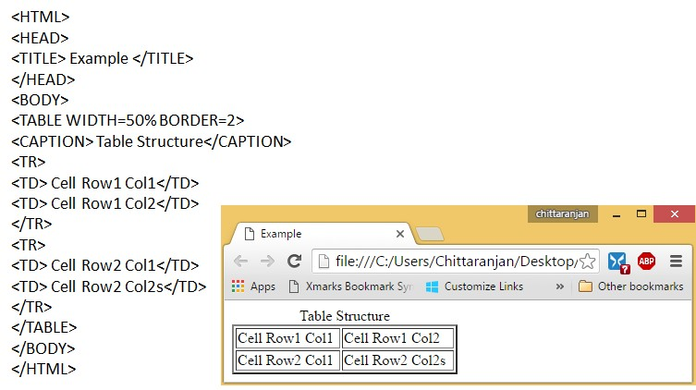
Tables
Tables
Border value indicates the thickness of the outermost table boundary in pixels
HTML
Meta Tag
Text Formatting Lists
Caption describes the title of table data
Tables
Frames

Slide 12
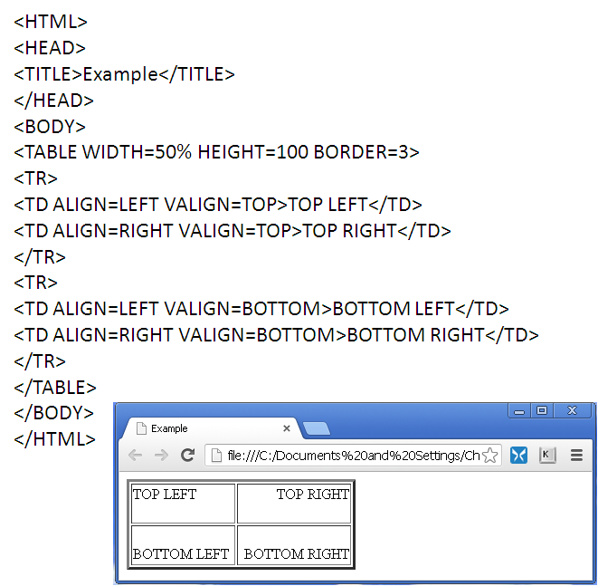
Tables...
Tables
ALIGN: Left, Right, Center VALIGN: Top, Bottom
HTML
Meta Tag
Text Formatting Lists
Tables
Frames

Slide 13
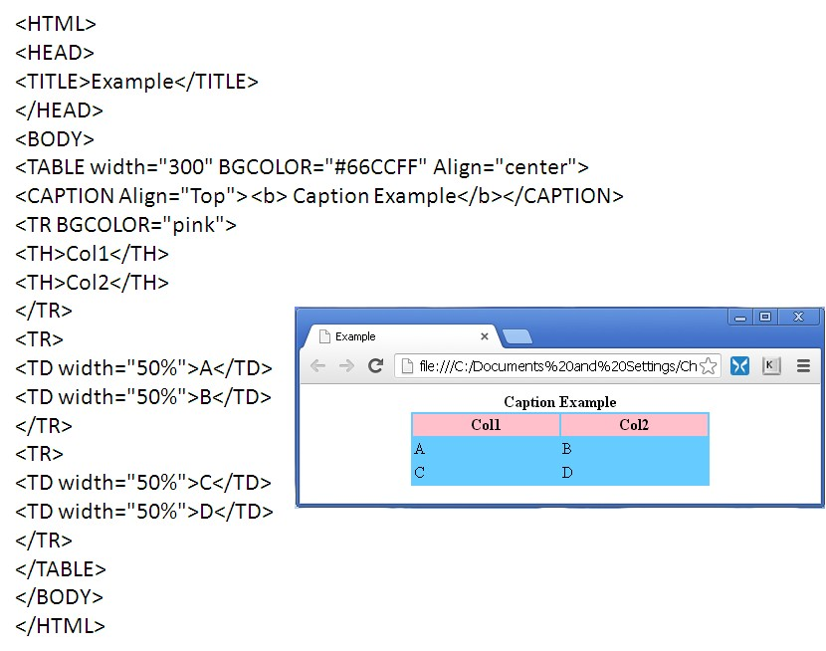
Tables...
Tables
Table Header helps to understand the meaning of data in a row/column
HTML
Meta Tag
Text Formatting Lists
Tables
Frames

Slide 14
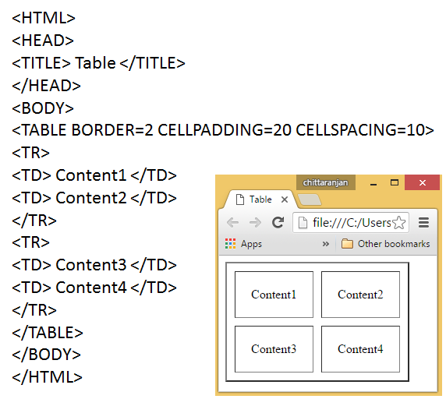
Tables...
Cellpadding & Cellspacing
Cellpadding is the amount of space between the edges of the cell and cell content. Cellspacing is the amount of space between the cell borders
HTML
Meta Tag
Text Formatting Lists
Tables
Frames

Slide 15
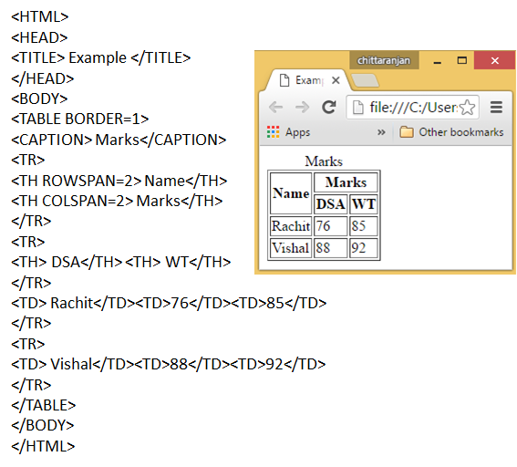
Tables...
Rowspan & Colspan
Rowspan indicates the number of rows a cell spans while
Colspan indicates the number of columns a cell spans
Tables
Frames

Slide 16
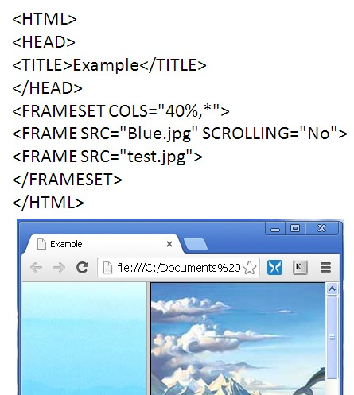
Frames
Frames
A web page may be divided into several blocks called frames. Each frame may display a separate web page
Frames are used to have the menu in one frame and the content in another frame
HTML
Meta Tag
Text Formatting Lists
Tables
Frames

Slide 17
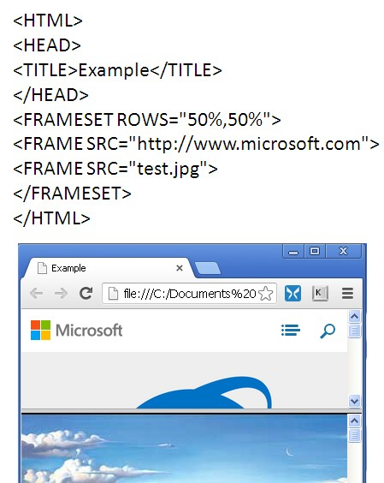
Frames
Frames
<FRAMESET> defines the characteristics of the frames such as number of frames to be created, orientation, width, height Nested frames are possible
HTML
Meta Tag
Text Formatting Lists
Tables
Frames

